Slide 1
Clinical BI Update
Segun Jung, PhD
Associate Director of R&D and Clinical Bioinformatics
16-MAR-2022

Slide 2

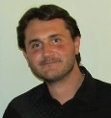
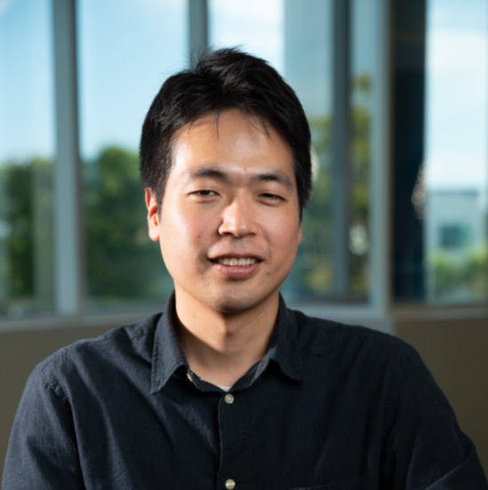
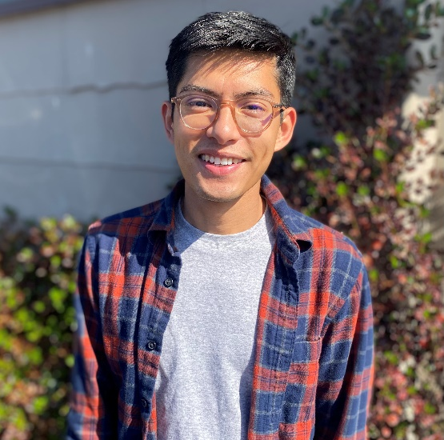
Bioinformatics Team (AV)
Segun Jung, PhD
Associate Director
- Computational Biology
- NYU/UChicago
- Trail Running -> MBA
Christophe Magnan, PhD
Sr. Bioinformatics Scientist
- Computer Science
- UC Irvine
- Camping
Hyunjun Nam, PhD
Bioinformatics Scientist
- Bioinformatics
- UCSD
- Tennis -> babysitting
Rudy Fabunan, MS
Bioinformatics Scientist
- Evolutionary Biology
- SDSU
- Running + dog

Slide 3
Introduction
Storage model
Clinical NGS pipelines (overview)
CNV
MSI
RNA expression
RNA fusion
Infrastructure
Challenges

Slide 4
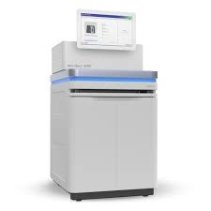
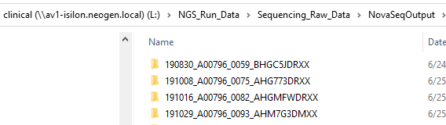
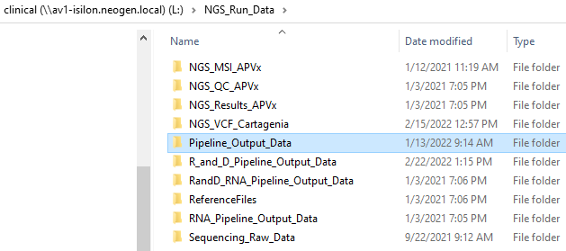
Storage Model
Sequencing data
DNA/RNA Pipeline output folders
Data transfer
Isilon network
IT: NGS raw data archiving every day for older than 6 months or 1 year
R&D: purging for non-essential data (i.e., intermediate bam files) every day
Total Size: 6.0P
Currently at 72% (03/15/22)

Slide 5
NGS Pipeline - Demultiplexing
QIAseq with custom recipe (11 dark cycle)
Detect incorrect sample sheet
FASTQ
QIAseq323: 96
QIAseq297:192
IDT: 96
Email notification to the lab
Summary file
Batch PASS/FAIL: Q30 > 80%
Sample >5M
NTC <1M
Incorrect sample sheet
Dumpltiplexing
Bcl2fastq v. 2.2
(~40min)
BCL (binary base call)
(36 hours)
Bclconvert v. 3.9
(~36min)
UMI processing and quality trimming
Fastp
(~15-20min)
Summary
QIAseq323 (DNA): ~100M reads
QIAseq297 (DNA/RNA): ~60M reads
IDT(RNA): ~30-60M reads
Total Time: ~ 1 hour
UMI location
QIAseq: 12nt in R2
IDT: 3nt in both R1 and R2

Slide 6
NGS Pipeline - Main
FASTQ
Parallelization whenever possible
DNA: hg19
Post-processing
Total Read Depth (>100)
Alt Read Depth (>10)
AF: 3% for hotspot and 5% for non-hotspot
Artifacts
LIMS
(APvX)
~2hrs
~1hrs
Alignment
(bwa mem)
UMI dedup
(fgbio)
Deduped Fastq
Ensemble Variant Calling
(vardict, mutect2, gatk4, platypus)
QC
VCF
BAM
CPU assigned by 16 x number of FASTQ
RNA: hg38
VAaAST
Post-processing
ML score filtering
Supporting reads
Artifacts
Alignment
(bwa mem, Star)
UMI dedup
(umitools)
Deduped Fastq
Ensemble Variant Calling
(fusioncatcher, arriba, starfusion)
BAM
VCF
VCF (MSI)
CNV
QC

Slide 7
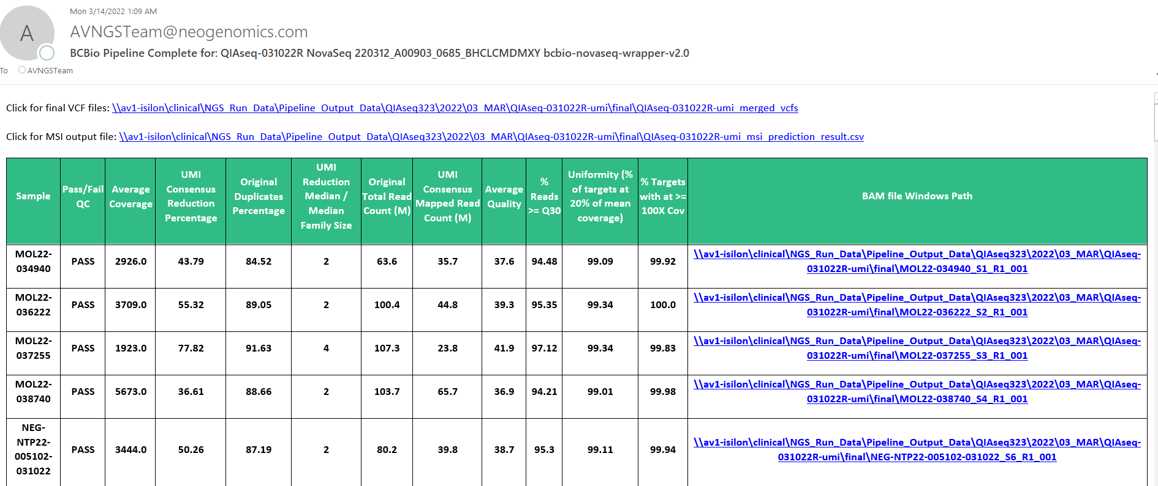
NGS Pipeline – Email notification

Slide 8
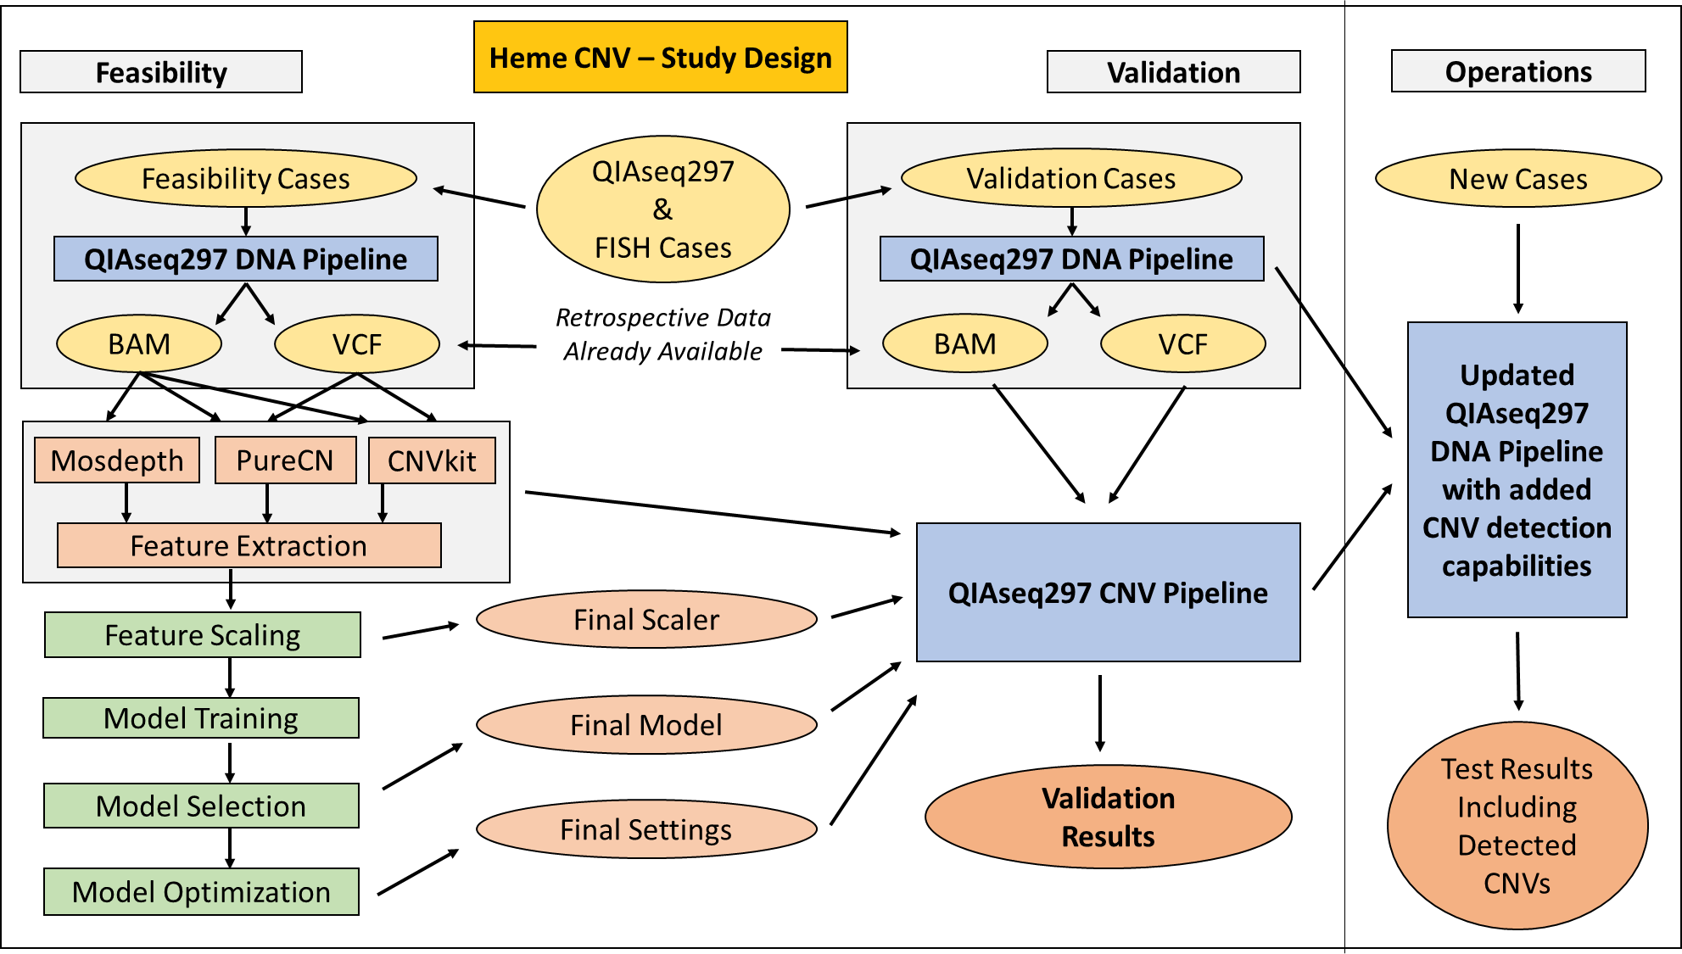
Heme CNV - Overview
Dr. Christophe Magnan

Slide 9
Heme CNV – Data Collection
Extracted Metadata Mapping, Merging,
And Filtering
FISH Reports
387,938 Total
FISH Results
Extraction
NGS Reports
113,456 Total
NGS Sample Metadata Extraction
Heme CNV Data
9,015 Concurrent Cases
364,210 Genes With CNV Information
From FISH
Isilon
257,951 BAM
176,547 VCF
NGS Data + Quality Controls

Slide 10
Heme CNV – Features
QIAseq297
Pipeline
270 genes covered by the CNV methods
VCF
BAM
PureCN
CNVkit
Mosdepth
Segment-Level Log₂(CN) x 4
Gene-Level Log₂(CN) x 6
Normalized Coverage 1
…
Normalized Coverage 10
Predictions From Existing Tools
PureCN and CNVkit selected
Baseline accuracy: 95% to 96%
Predicted Log₂(CN) used as found
Gene and segment level results
Confidence intervals included
Expected > 0 for gain and < 0 for loss
Normalized Coverages
Classic and experimental features
11K samples to assess assay-specific coverage variations and biases
Comparison between gene coverage and other elements / expected normal
Expected > 1 for gain and < 1 for loss
Dr. Christophe Magnan

Slide 11
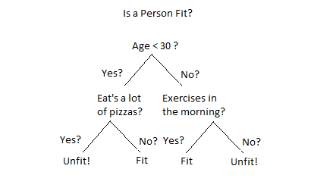

Heme CNV – Random Forest Classifier
Gene with unknown CNV information
252,858 genes with known CNV information
Features +
Random Forest
Training Algorithm
CNV Result
Features
Random Forest CNV Model
CNV Result
CNV Prediction
Loss: 71.23%
Gain: 03.56%
Normal: 25.21%

Slide 12
Heme CNV – Pipeline Validation

Slide 13
Heme CNV – Pipeline Validation Results
Model evaluated on each of the 62 genes
111,352 individual tests performed (1 gene x 1 sample)
Baseline accuracy (CNVkit, PureCN): 95% to 96%
Validation results summary:
Performance Characteristics | Percentage
Accuracy | 98.17%
Sensitivity | 95.98%
Specificity | 98.36%

Slide 14
Heme CNV –Pipeline Validation Summary
Ensemble approach provides between 2% and 3% improvement
Limit of detection: 20% abnormal cells / tumor content
No limitation on the number of copies above the LOD
Homozygous/heterozygous deletions both detected
Gains detected with as low as 3 copies of the gene
No matched normal sample required
270 QIAseq297 genes covered by the methods
3 genes included in the recently launched ALL panel

Slide 15
MSI for Solid Tumor – Training
Panel | negative samples | positive samples
NeoTYPE™ Colorectal Tumor Profile | 30 | 17
NeoTYPE™ Lung Tumor Profile | 14 | 9
NeoTYPE™ Discovery Profile for Solid Tumors | 8 | 2
NeoTYPE™ Breast Tumor Profile | 5 | 1
NeoTYPE™ Pancreas Tumor Profile | 5 | 2
NeoTYPE™ Other Solid Tumor Profile | 4 | 1
NeoTYPE™ Endometrial Tumor Profile | 3 | 16
NeoTYPE™ Ovarian Tumor Profile | 3 | 1
NeoTYPE™ Precision Profile for Solid Tumors | 3 | 0
NeoTYPE™ Brain Tumor Profile | 2 | 1
NeoTYPE™ Esophageal Tumor Profile | 2 | 0
NeoTYPE™ Gastric Tumor Profile | 2 | 2
NeoTYPE™ GI Predictive Profile | 2 | 1
NeoTYPE™ Melanoma Profile | 2 | 0
NeoTYPE™ Cervical Tumor Profile | 1 | 1
NeoTYPE™ Head & Neck Tumor Profile | 1 | 0
NeoTYPE™ Liver/Biliary Tumor Profile | 1 | 0
Total | 88 | 54
Training dataset
MSI-H
(n=54)
Baseline
(FFPE normal, MSS)
Feature selection
(59 loci)
MSS
(n=88)
All samples in training/validation confirmed by Promega PCR assay or IHC
CSV-SVPLR-0057-01
Rudy Fabunan

Slide 16
MSI for Solid Tumor – 59 Markers
BAT40 | D3S1029 | D8S87 | KMT2D | GID4 | D20S100
AKT3 | ATR | D8S87 | POLE | D17S250 | EP300
MONO-27 | BAT25 | PRKDC | D13S175 | D17S787 | EP300
MSH2/BAT26 | D5S346 | TSC1 | HSP110-T17 | D18S35 | RBM10
MSH2 | CTNNA1 | D10S196 | D13S153 | TCF | AR
MSH6 | NPM1 | MRE11A | NR21 | D18S69 | AR
D2S123 | ARID1B | ATM | RAD51B | D18S64 | AR
XPO1 | PMS2 | ATM | RAD51B | D18S55 | STAG2
NR24 | D7S519 | NR22 | CREBBP | D18S61 | STAG2
TGFBR2 | D7S519 | KMT2D | BAT34C4 | TOP1

Slide 17
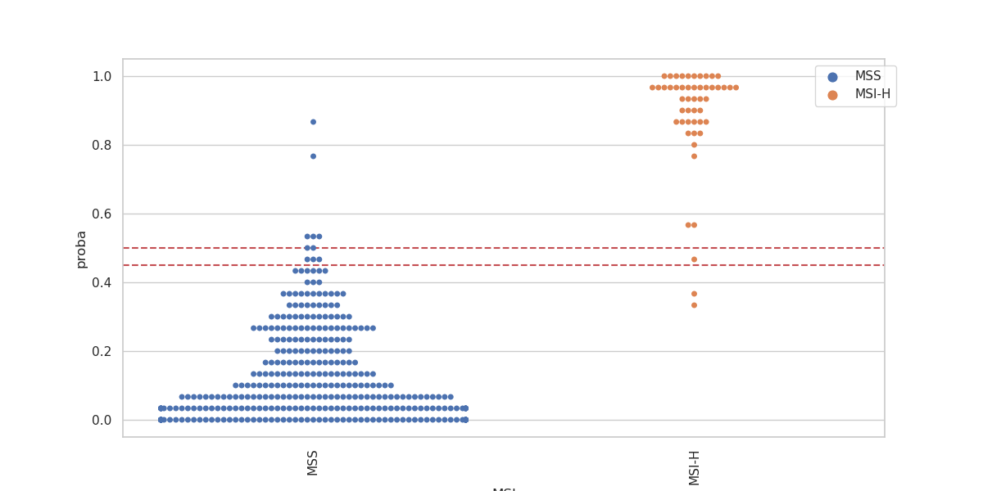
MSI for Solid Tumor –Val01
Prediction model
(59 loci)
Val data
(393 samples)
Indeterminate range: 0.45 <= x <= 0.5
MSS
True call
MSI-H
TP | TN | FP | FN | Sen | Sep | Acc
47 | 339 | 5 | 2 | 96% | 99% | 98%
All samples in training/validation confirmed by Promega PCR assay or IHC

Slide 18
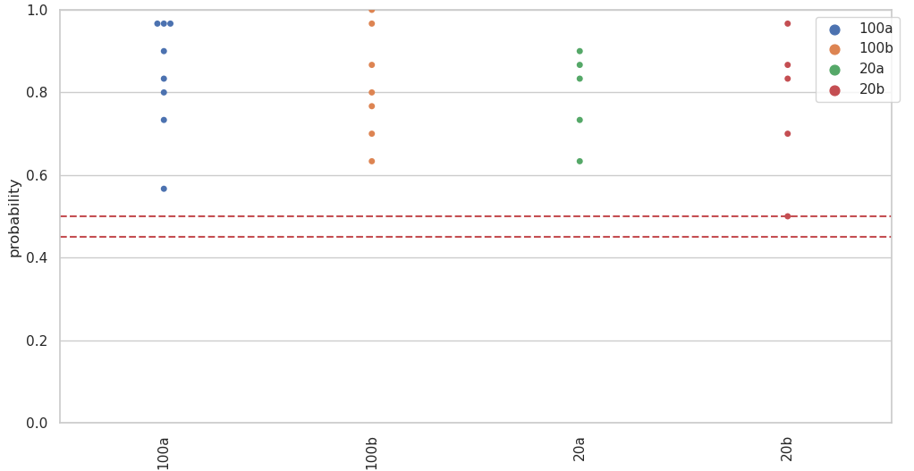
MSI for Solid Tumor –Val02
DNA input amount
Probability comparison for 100 ng vs 20 ng
@20ng – 4 sample QC fail due to average coverage < 500X

Slide 19
MSI for Solid Tumor –Val03
Sample | True_call | MSI prediction | probability
A01-MSI01-20ng | MSI-H | MSS | 0.4
A02-MSI01-20ng | MSI-H | MSI-H | 0.73333333
A03-MSI01-20ng | MSI-H | MSI-H | 0.8
A04-MSI01-100ng | MSI-H | MSI-H | 0.9
A05-MSI01-100ng | MSI-H | MSI-H | 0.8
B01-MSI02-20ng | MSI-H | MSI-H | 0.73333333
B02-MSI02-20ng | MSI-H | MSI-H | 0.73333333
B03-MSI02-20ng | MSI-H | MSI-H | 0.6
B04-MSI02-100ng | MSI-H | MSI-H | 0.8
B05-MSI02-100ng | MSI-H | MSI-H | 0.53333333
C02-MSI03-20ng | MSI-H | MSI-H | 0.93333333
C03-MSI03-20ng | MSI-H | MSI-H | 0.73333333
C04-MSI03-100ng | MSI-H | MSI-H | 0.96666667
C05-MSI03-100ng | MSI-H | MSI-H | 0.86666667
@20ng & @20% - rare to receive in the lab
MSI04 & MSI05 omitted due to a sample issue

Slide 20
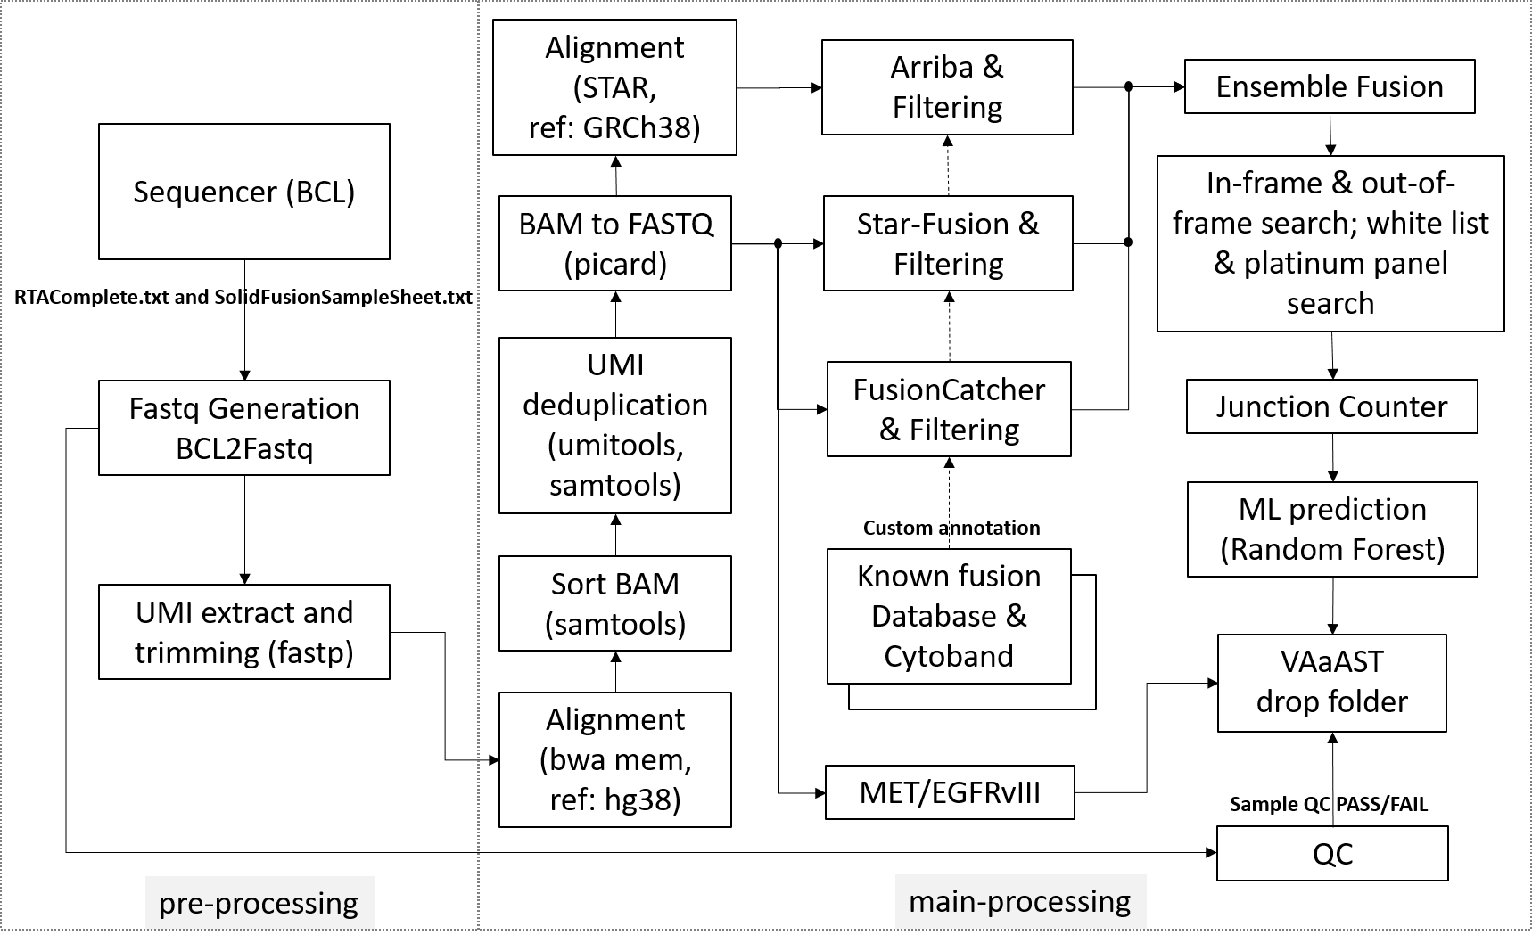
RNA Solid Fusion
Strong fusion
25 supporting reads
Probability >0.5
Weak fusion
10 to 24 supporting reads
Probability >0.5
Require orthogonal confirmation
MET Exon 14 skipping & EGFRvIII mutation
Counting the chimeric junction sequence match
Positive: >50
Negative: < 10
Indeterminate: 10<x<50
Launched in January, 2021
CSV-SGFGS-0135_012621
Dr. Brad Thomas

Slide 21
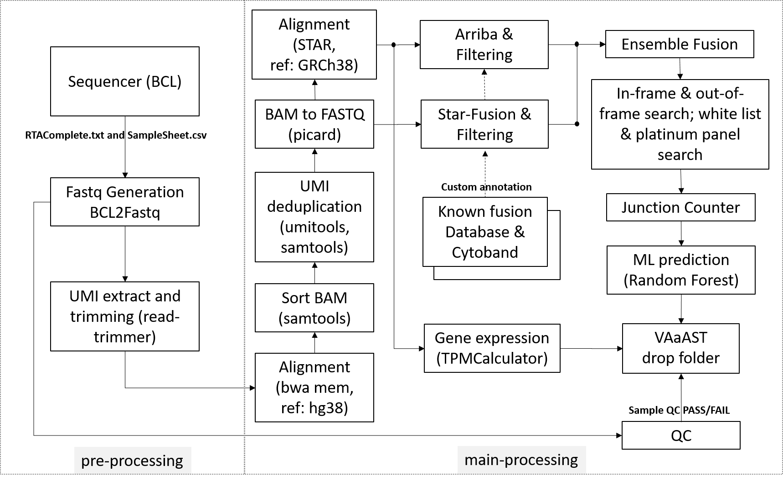
RNA Heme Fusion & Expression (ALL)
Fusion-positive
5 supporting reads
Probability >0.5
Expression
TPM values normalized by GUSB housekeeping gene
Cutoff established by Fei’s team
ALL launched
Launched in February, 2022
CSV-SGFGS-0179-01
Dr. Abhisek Ghosal

Slide 22
Infrastructure
(1) Support the clinical lab/operations in AV (and FM) to minimize TAT
(2) Support Laboratory Developed Test (LDT) development
36 hrs
Avg. 5 hrs
A few days?
NGS Sequencing
BI QC
Data Analysis
Review & Reporting
DNA/TNA
NovaSeq
Infrastructure
128 cores
1144 cores
1808 cores
1808 cores
?
20 - 27 hrs
(Jul. 2019 ─ Oct. 2020)
Avg. 10 hrs
(Oct. 2020 ─ Apr. 2021)
Avg. 5 hrs
(Since Apr. 2021)
Pipeline optimization
Philip Torticill

Slide 23
Infrastructure
Production Cluster in AV by the end of March
40 compute nodes (3728 CPUs)
CentOS 7/PCS cluster/Torque 6.0.1/Maui
List of pipelines
Heme/Solid DNA pipelines
Heme/Solid RNA pipelines
Heme/Solid RNA QC pipelines
Additional offering
NGS only Solid Lung 2.0 launch
Comprehensive/Discovery launch
Solid RNA Volume increases
Heme ALL
Issues
In general, 3-4 batches of Heme/Solid in the cluster (96 samples per batch) instead of 2 batches
Only two-three batches, but Solid RNA batches
Deploy the pipelines to other locations
Improvement
Increase # of CPUs per sample (i.e. 16 -> 24)
Improve in alignment with bwa-mem2
GPU
node1
node2
node3
Head node
….
node39
node40
Compute node
node1
Head Node
node2
Compute Node
R&D Cluster
2 compute nodes (184 CPUs)

Slide 24
Challenges
Staffing – current opening
Sr. Bioinformatics Scientist (Christophe’s replacement)
Bioinformatics Scientist (Hyunjun’s replacement)
Cloud Bioinformatics Engineer (on hold until Q3 per HR)
Hard to get good bioinformatician (quality vs. compensation)
Scalability
Need to implement a cloud option in case the volume in the lab increases

Slide 25
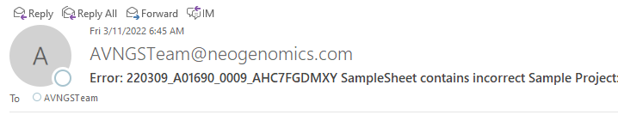
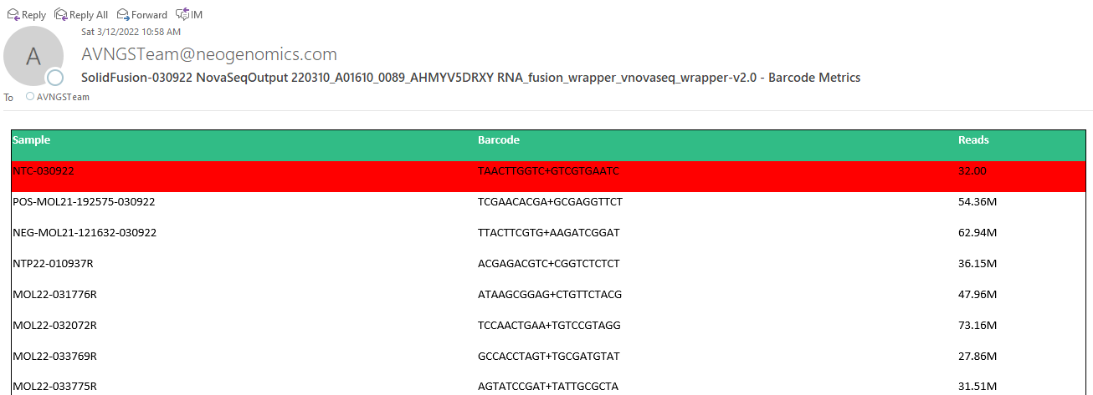
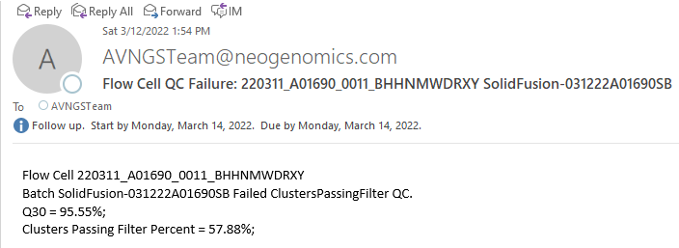
NGS Pipeline - Demultiplexing
Email notification examples

Slide 26
Pipeline Validation Results (2)
Highest concordance when comparing NGS and FISH at the exact same location
Gene | Direction | Positive Cases |  |  | Negative Cases |  |  | All Cases
 |  | Total | Conc. | Sensitivity | Total | Conc. | Specificity | Total | Conc. | Accuracy
ATM | loss | 72 | 72 | 100.00% | 641 | 629 | 98.13% | 713 | 701 | 98.32%
CBFB | loss | 23 | 22 | 95.65% | 517 | 506 | 97.87% | 540 | 528 | 97.78%
EGR1 | loss | 171 | 169 | 98.83% | 1,541 | 1,538 | 99.81% | 1,712 | 1,707 | 99.71%
KMT2A | gain | 27 | 25 | 92.59% | 474 | 472 | 99.58% | 501 | 497 | 99.20%
MET | loss | 113 | 113 | 100.00% | 1,593 | 1,582 | 99.31% | 1,706 | 1,695 | 99.36%
NF1 | loss | 15 | 15 | 100.00% | 908 | 908 | 100.00% | 923 | 923 | 100.00%
TERT | loss | 10 | 10 | 100.00% | 1,723 | 1,709 | 99.19% | 1,733 | 1,719 | 99.19%
TP53 | loss | 76 | 73 | 96.05% | 1,567 | 1,556 | 99.30% | 1,643 | 1,629 | 99.15%

Slide 27
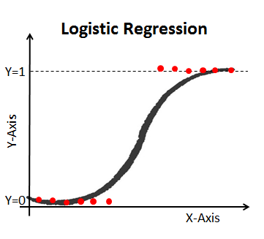
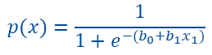
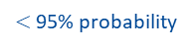
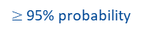
MSI Prediction Scheme
Training dataset
Logistic regression with LBFGS solver
MSI-H
(n=93)
MSI-H
MSI-H
msisensor
$≥$ 95% probability
MSS
(n=157)
MSS
?
Prediction model
REFLEX
$$p(x)=\frac{1}{1+e^{−(b_{0}+b_{1}x_{1})}}$$
$<$ 95% probability
Blind dataset
Clinical Samples
msisensor
MSS
$≥$ 95% probability

Slide 28
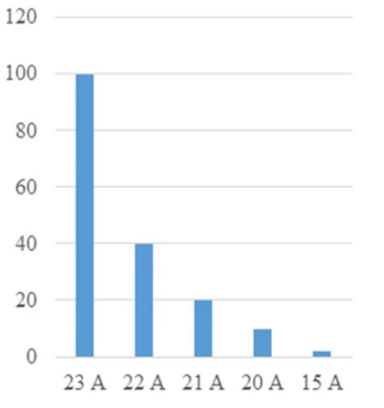
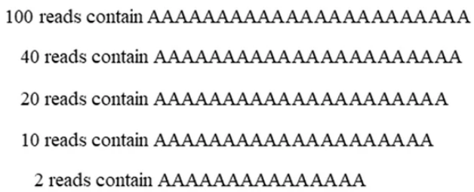
Features -- Peaks

Slide 29
Solid CNV – Summary
Normal dataset established aligned with the QC in current validation report
QC criteria
Minimum 5M reads and 500X avg. coverage
Uniformity: 95%
100X: 98%
Pool of Normas: 15 TNA
Retrospective cases collected and data processed
A single cutoff
0.4 for amplification (except for ERBB2 at 0.2) and -0.35 deletion
panel of normals (TNA: N =15)
gene | Log2 cutoff | Dataset |  |  |  | Performance
 |  | training (60%) |  | validation (40%) |  | training (60%) |  |  |  |  |  |  | validation (40%)
 |  | positive | negative | positive | negative | TP | TN | FP | FN | Sen | Spe | Acc | TP | TN | FP | FN | Sen | Spe | Acc | Acc
MET | 0.4 | 115 | 4722 | 41 | 2033 | 100 | 4321 | 431 | 15 | 0.87 | 0.91 | 0.91 | 35 | 1866 | 177 | 6 | 0.85 | 0.91 | 0.91 | 0.91
ERBB2 | 0.2 | 126 | 1687 | 82 | 1128 | 87 | 1593 | 106 | 39 | 0.69 | 0.94 | 0.92 | 64 | 1054 | 80 | 20 | 0.76 | 0.93 | 0.92 | 0.92
EGFR | 0.4 | 14 | 138 | 3 | 99 | 13 | 118 | 20 | 1 | 0.93 | 0.86 | 0.86 | 2 | 86 | 13 | 0 | 1 | 0.87 | 0.87 | 0.87
PTEN | -0.35 | 70 | 1639 | 47 | 1092 | 42 | 1387 | 252 | 28 | 0.6 | 0.85 | 0.84 | 27 | 913 | 179 | 20 | 0.57 | 0.84 | 0.83 | 0.83

